Slide 1
Fresh Grads – Group Project
Blog application

Slide 2
Problem Statement
To Create an Blogging Application like Reddit. Different users are :
SuperUser or Admin
Moderator
Blogger
Admin should be able to create and manage communities
Moderator should be able to shadow a content from being published if the post doesn’t meet the postAllowedRules
Blogger should be able to register himself/herself. Blogger should be able to :
Search on communities , create a post (text,video,link,poll)
comment on the other posts of the community of which he/she is a part of.
Upvote or downvote other posts

Slide 3
Road Map
Application will be developed in following Sprints –
Core Java +JPA with Hibernate
Spring Boot + Rest Controller + JPA with Hibernate
Angular for UI design (Front End) + Integration with previous Sprint

Slide 4
Plan
Design
Generate the skeleton as per class design provided
TDD approach
Identify test cases for each module
Write Failing Test cases
Convert the Test Cases in GREEN
Implement the case study in incremental manner

Slide 5
Modules
Login Module
Admin Module
BloggerModule
ModeratorModule
PostCreationModule
SearchModule

Slide 6
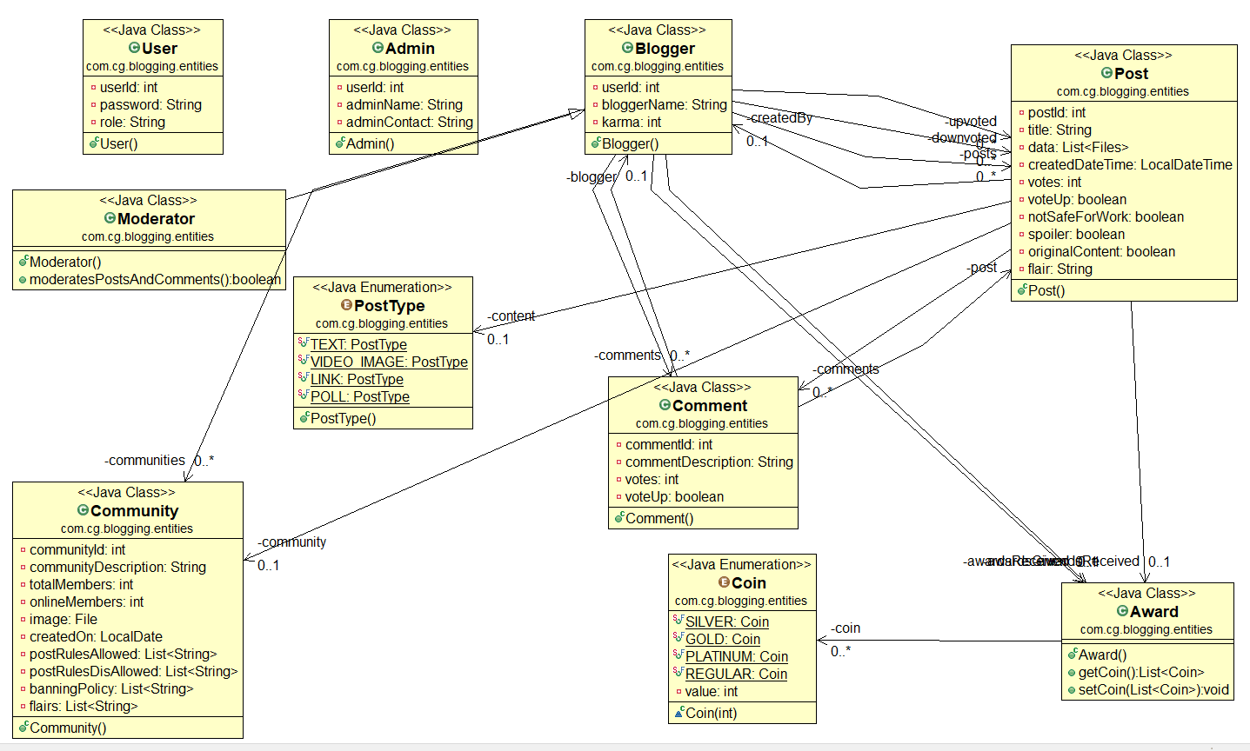
Class Design
POJO Classes:

Slide 7
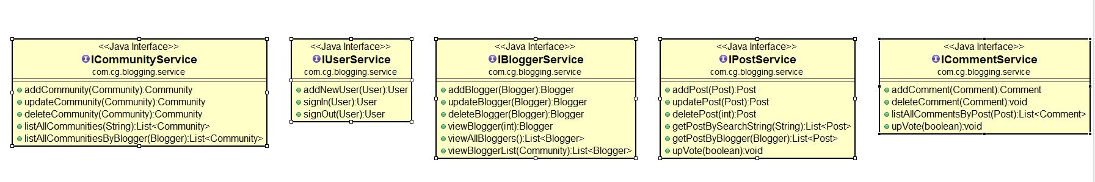
Class Design
Service Interface:

Slide 8
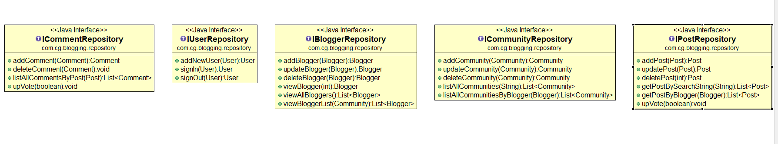
Class Design
Repository:

Slide 9




Questions

